Slide 1
Tutorial 2: DESeq2
Mark Young

Slide 2
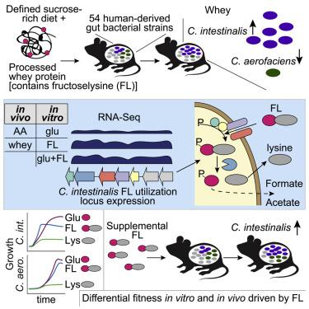
Today’s data: Wolf et al, 2019 (Ashley’s postdoc work)
Observation: When mice are fed fructoselysine (FL), the relative abundance of C. intestinalis increases, while C. aerofaciens decreases.
Weird because both carry the genes for metabolizing FL
Finding: Glucose represses FL metabolism in C. aero. They’re wired differently

Slide 3
Why FL is interesting
FL: A maillard reaction product (MRP) common in highly processed foods (like whey protein)
Translational importance: How eating processed foods changes the composition of the microbiome. How microbes might influence food safety
Microbiology: Evolution of carbon catabolite repression. Why would C. aerofaciens want to repress FL metabolism?

Slide 4
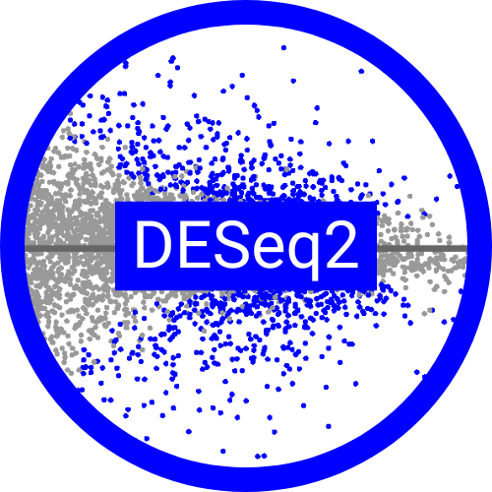
We’re re-running the differential expression analysis
In class: Differential expression of C. intestinalis genes on various in vitro media
Homework: Again, but on C. aerofaciens
Differential expression tool: DESeq2
Platform: biohub, R
What this shows us: C. intestinalis doesn’t downregulate FL metabolism in the presence of glucose. In contrast, C. aerofaciens does.

Slide 5
A probabilistic measure of expression
Gene of interest
Define p: underlying proportion of blue reads
Sequenced reads
Total reads

Slide 6
A probabilistic measure of expression
Gene of interest
Define p: underlying proportion of blue reads
Then the probability of observing b blue reads followed by k black reads is
P(b, k) = p^{b}(1-p)^{k}
Sequenced reads
Total reads

Slide 7
A probabilistic measure of expression
Gene of interest
Define p: underlying proportion of blue reads
Then the probability of observing b blue reads followed by k black reads is
P(b, k) = p^{b}(1-p)^{k}
And the probability of seeing them in any order (permutation) is
P(b, k) = (^{k+}_{k}^{b - 1})p^{b}(1-p)^{k}
Sequenced reads
Total reads

Slide 8
A probabilistic measure of expression
Gene of interest
Define p: underlying proportion of blue reads
Then the probability of observing b blue reads followed by k black reads is
P(b, k) = p^{b}(1-p)^{k}
And the probability of seeing them in any order (permutation) is
P(b, k) = (^{k+}_{k}^{b - 1})p^{b}(1-p)^{k}
Sequenced reads
Total reads
We call this the “negative binomial”
Notes:
-1 because the last one is ordered! We always see the last r last.

Slide 9
DESeq2 is built on the negative binomial
Basic DESeq2: Does the same rate parameter (p) explain expression in both treatment groups?
How it gets there: Generalized linear models
Define the random component for sample j (we did this on the last slide!):
b_{j}~NB(p_{j}, k_{j})
Model the rate parameter as a function of regression coefficients (this is the linear regression part)
p_{j} ~x_{j}𝛽_{j}
Test if p is actually dependent on 𝛽

Slide 10
DESeq2 is built on the negative binomial
Basic DESeq2: Does the same rate parameter (p) explain expression in both treatment groups?
How it gets there: Generalized linear models
Define the random component for sample j (we did this on the last slide!):
b_{j}~NB(p_{j}, k_{j})
Model the rate parameter as a function of regression coefficients (this is the linear regression part)
p_{j} ~x_{j}𝛽_{j}
Test if p is actually dependent on 𝛽

Slide 11
DESeq2 is built on the negative binomial
Basic DESeq2: Does the same rate parameter (p) explain expression in both treatment groups?
How it gets there: Generalized linear models
Define the random component for sample j (we did this on the last slide!):
b_{j}~NB(p_{j}, k_{j})
Model the rate parameter as a function of regression coefficients (this is the linear regression part)
p_{j} ~x_{j}𝛽_{j}
Test if p is actually dependent on 𝛽

Slide 12
DESeq2 is built on the negative binomial
Basic DESeq2: Does the same rate parameter (p) explain expression in both treatment groups?
How it gets there: Generalized linear models
Define the random component for sample j (we did this on the last slide!):
b_{j}~NB(p_{j}, k_{j})
Model the rate parameter as a function of regression coefficients (this is the linear regression part)
p_{j} ~x_{j}𝛽_{j}
Test if p is actually dependent on 𝛽

Slide 13
DESeq2 is built on the negative binomial
Basic DESeq2: Does the same rate parameter (p) explain expression in both treatment groups?
How it gets there: Generalized linear models
Define the random component for sample j (we did this on the last slide!):
b_{j}~NB(p_{j}, k_{j})
Model the rate parameter as a function of regression coefficients (this is the linear regression part)
p_{j} ~x_{j}𝛽_{j}
Test if p is actually dependent on 𝛽

Slide 14
Getting started: back to the biohub
Navigate back to https://biology.datahub.berkeley.edu/
Open a terminal and clone the class repository:
git clone https://github.com/CCB293/Fall-2025.git
Open the tutorial notebook
Load the R Kernel

Slide 15
Reading in the data that has been mapped to C. intestinalis: what that means
DESeq2 takes counts, not raw reads.
How Ashley got those:
Raw reads were mapped to a reference genome with Bowtie2
Bacteria don't have alternative splicing so Ashley didn’t need to use one of the splice-aware aligners designed for eukaryotes
Bowtie2 output was used to count how many reads aligned to each gene
Methods don’t say, but probably featureCounts or HTSeq
Counting of polycistronic mRNAs sometimes messed up by this choice

Slide 16
Shrunk vs not shrunk
By default, DESeq2 gives us a maximum likelihood estimator of βs (fold changes)
β*=argmax(P(data|β))

Slide 17
Shrunk vs not shrunk
By default, DESeq2 gives us a maximum likelihood estimator of βs (fold changes)
β*=argmax(P(data|β))
For shrinkage, we add in prior belief about the system. Namely, most genes are not DE

Slide 18
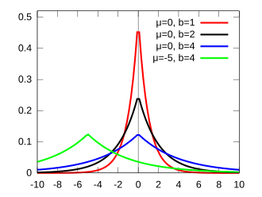
Shrunk vs not shrunk
By default, DESeq2 gives us a maximum likelihood estimator of βs (fold changes)
β*=argmax(P(data|β))
For shrinkage, we add in prior belief about the system. Namely, most genes are not DE
We assume β ~ Laplace(0, b)

Slide 19
Shrunk vs not shrunk
By default, DESeq2 gives us a maximum likelihood estimator of βs (fold changes)
β*=argmax(P(data|β))
For shrinkage, we add in prior belief about the system. Namely, most genes are not DE
We assume β ~ Laplace(0, b)
We use Bayes rule to find a posterior distribution on β
P(β|data) ∝ P(data|β)P(β)

Slide 20
Shrunk vs not shrunk
By default, DESeq2 gives us a maximum likelihood estimator of βs (fold changes)
β*=argmax(P(data|β))
For shrinkage, we add in prior belief about the system. Namely, most genes are not DE
We assume β ~ Laplace(0, b)
We use Bayes rule to find a posterior distribution on β
P(β|data) ∝ P(data|β)P(β)
“Posterior”
(maximized)
“likelihood”
(default DESeq2)
“prior”
(beliefs)

Slide 21
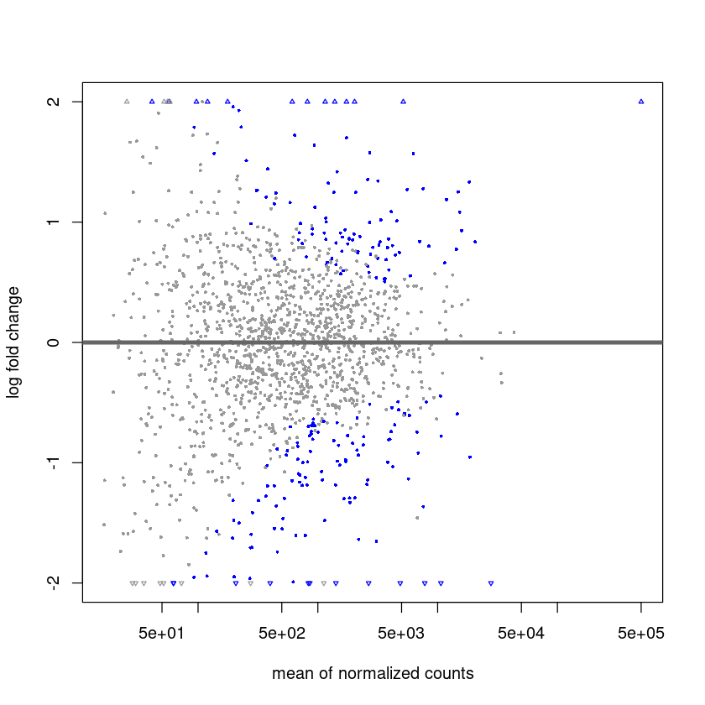
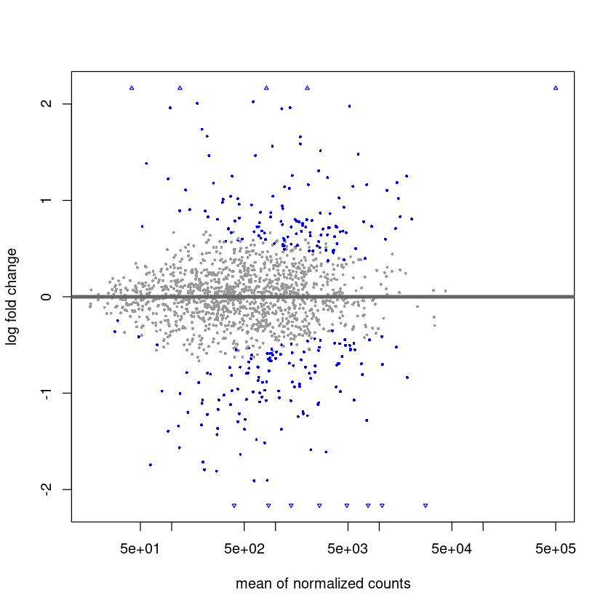
Shrunk vs not shrunk
P(β|data) ∝ P(data|β)P(β)
More reads == more trust in the likelihood, less attention payed to prior belief

Slide 22
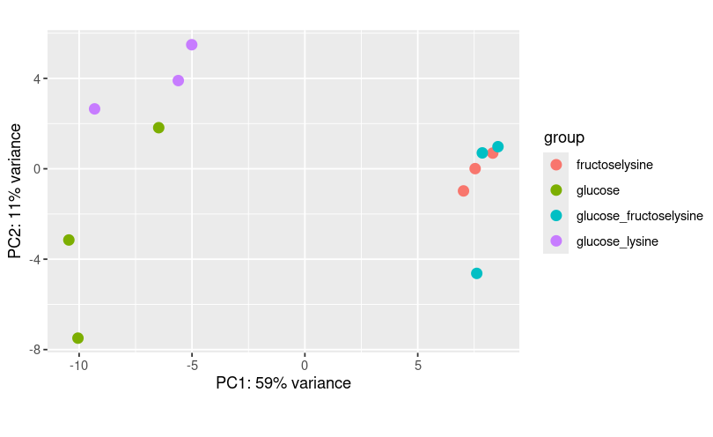
PCA results: what these mean
The FL and the G + FL treatments are expressing the same genes
G and G+L are similar on PC1
Tells us that C. intestinalis changes gene expression in the presence of FL, regardless of glucose presence (no carbon catabolite repression)

Slide 23

Our top gene: COLINT_02684
From BV-BRC:
LFC: -5.48348
(down without FL)
Corrected p value: 5.22957e-153
Bacterial PTS systems
Phosphoenolpyruvate:carbohydrate phosphotransferase
Used for importing carbohydrates (like FL!) into a cell
Phosphorylates so they can enter stuff like glycolysis

